Slide 1
Semantic Networks and Frames

Slide 2
Semantic networks - history
Network notations are almost as old as logic
Porphyry (3rd century AD) – tree-based hierarchies to describe Aristotle’s categories
Frege (1879) - concept writing, a tree notation for the first complete version of first-order logic
Charles Peirce (1897) – existential graphs
First implementation of semantic networks
Masterman (1961) – defines 100 concept types which are used to define 15,000 concepts organised in a lattice
Quillian (1967) – word concepts, defines English words in terms of other words

Slide 3
Semantic Network
An long existing notion:
there are different pieces of knowledge of world, and they are all linked together through certain semantics.

Slide 4
Semantic networks - history
Developed by Ross Quillian, 1968, as “a psychological model of associative memory”.
Associationist theories
define the meaning of an object in terms of a network of associations with other objects in a domain
Based on this idea of networks of information and knowledge
And on evidence that we also organise that knowledge hierarchically.
Notes:
When we see an object in the world and reason about it, that perception of an object is first mapped onto a concept in our minds.
This concept is either already part of our knowledge of the world or we form a new concept to hold it.
It is then connected through appropriate relationships with other concepts.
For example, if we think of the word snow we can associate this with the concepts white, ice, cold, snowman, slippery, etc. Thus, via our interpretation of this network we can make assertions about the truth of statements such as snow is white.

Slide 5
Semantic networks - history
Devised from laboratory testing of human response times to questions.
They were asked questions such as “Is a canary a bird?”, “Can a canary sing?”, or “Can a canary fly?”
Tests showed that response times for questions such as “Can a canary fly?” were longer than “Can a canary sing?”.
The results of this test were analysed and Quillian concluded that humans store information at its most abstract level
Notes:
The questions posed to subjects focused principally on properties of birds.

Slide 6
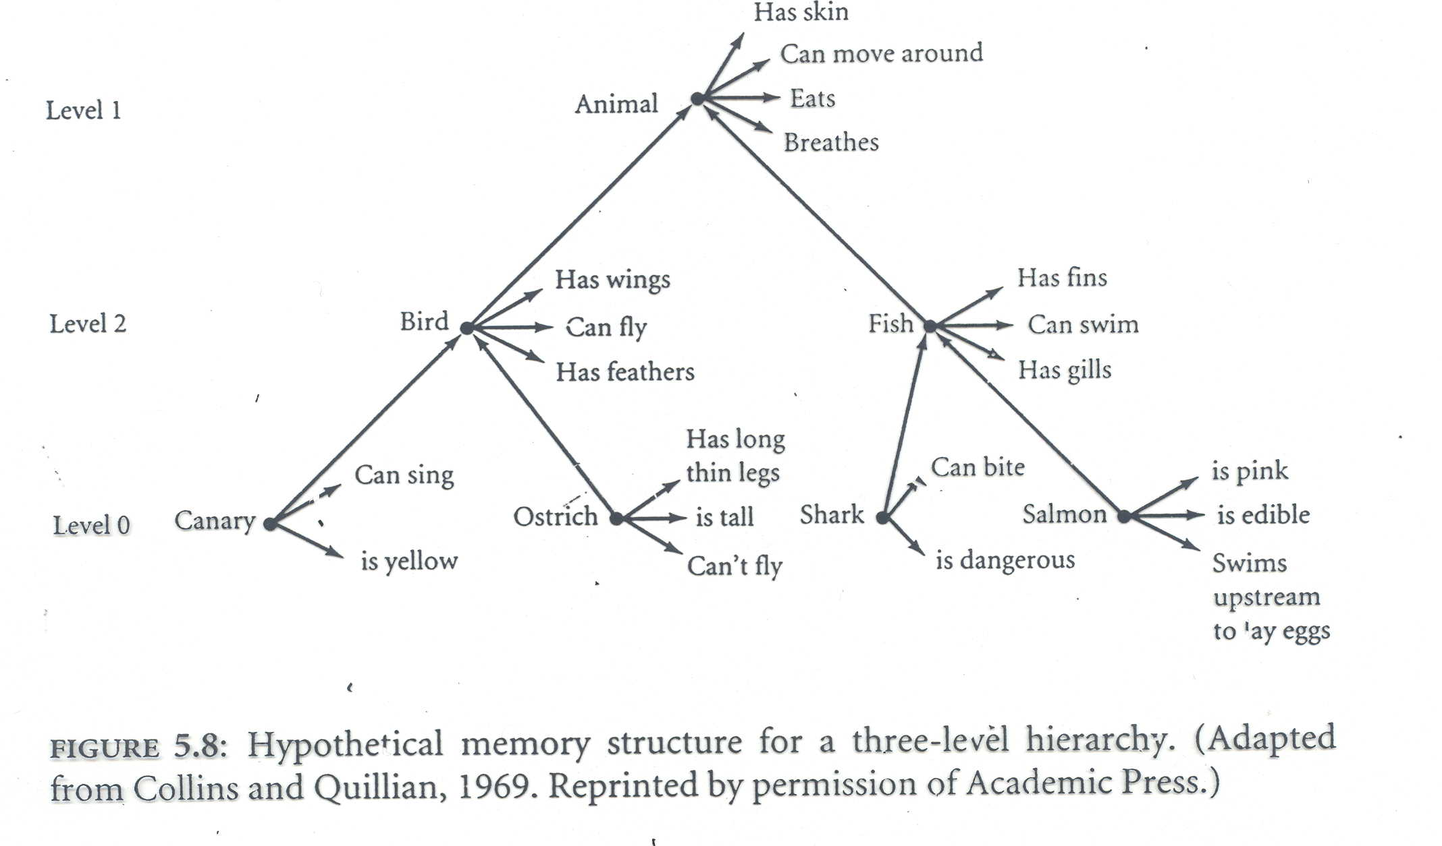
Semantic networks - history

Slide 7
Semantic networks
Instead of trying to recall that a canary flies, and a robin flies, and a swallow flies etc., humans remember that canaries, robins, swallows etc. are birds and that birds usually have an associated property of flying.
More general properties, such as eating, breathing, moving etc. are stored at an even higher level associated with the concept animal.
Thus reaction times to questions such as “Can a canary breathe?” were even longer again as more travel up the hierarchy is necessary to determine the answer.
The fasted recall was for traits specific to the bird such as “Is a canary yellow?” or “Can a canary sing?”

Slide 8
Handling exceptions
Handling exception cases also appears to be done at the most specific level.
Consider the properties associated with an ostrich in the semantic network. When subjects were asked if an ostrich could fly, the answer was produced faster than when applying the same question to canaries.
The conclusion reached by this is that the hierarchy
ostrich -> bird -> animal
is not traversed in order to understand this exception information.
Inheritance systems allow us to store information at the highest level of abstraction – this then reduces the size of the knowledge base and helps prevent update inconsistencies.

Slide 9
What is a semantic network?
animal
isa
isa
reptile
mammal
has_part
head
isa
large
size
elephant
colour
grey
instance_of
instance_of
Clyde
Nellie
likes
apples

Slide 10
Semantic networks: syntax
Represented as a graph.
Nodes represent concepts, actions or objects in the world.
Links represent directional and labeled relationships between the nodes.
Inheritance-oriented links: ”isa”, ”instance_of”
General links: ”has_part”, ”causes”
Domain-specific links: ”has_disease”, ”father_of”

Slide 11
Semantic network – example 1
Bilbo
instance_of
hobit
isa
person
agent
object
instance_of
find
magicRing
ring
location
cave
owner
Gollum

Slide 12
Semantic network – example 2
Bilbo
instance_of
hobit
isa
person
agent
event5
object
instance_of
magicRing
ring
location
instance_of
owner
Gollum
cave7
find
instance_of
cave

Slide 13
Problems with semantic networks
Naming standards
lack of naming standards for relationships
naming of nodes
If a node is labelled ‘chair’ does it represent:
A specific chair,
The class of all chairs,
The concept of a chair,
The person who is the chair of a meeting?

Slide 14
Problems with semantic networks
For a semantic network to represent definitive knowledge, i.e. knowledge that can be defined, the relationship and node names must be rigorously standardised.
Often it is hard to distinguish between
statements about object relationships with the world, and
properties of the object
Unable to represent
Negation
Quantification
Disjunction

Slide 15
Semantic networks
Semantic networks nowadays
Conceptual graphs (John Sowa)
SNePS (Stuart Shapiro)

Slide 16
Frames
Frames are a variant of semantic networks
A frame is
“a data structure for representing a stereotypical situation like …going to a child’s birthday party” (Minksy 1981).
All the information relevant to a concept is stored in a single complex entity called a frame.
Superficially, frames look like record data structures or class, however, at the very least frames also support inheritance.
class Book {
Person author;
String title;
int price;
}

Slide 17
Frames
In frame-based systems we refer to
objects – Mammal, Elephant, and Nellie;
slots – properties such as colour and size;
slot-values – values stored in the slots, e.g. grey and large.
Slots and the corresponding slot-values are inherited through the class hierarchy

Slide 18
Frames - example
The previous example can be also represented as frames:
Mammal:
subclass: Animal
has-part: head
Elephant:
subclass: Mammal
colour: grey
size: large
Nellie:
instance: Elephant
likes: apples
Clyde:
instance: Elephant
animal
isa
mammal
has_part
head
isa
large
size
elephant
colour
grey
instance_of
instance_of
Clyde
Nellie
likes
apples

Slide 19
Inheritance and default values
In general children classes inherit the properties of the parent class
Default values - properties that are typical for a class
Instances or subclasses whose properties differ from these default values are able to override them.
There are various ways of achieving overriding, for example:
any default value may be overridden.
only marked slots allow the default value to be overridden.

Slide 20
Default values
In this example only slots marked with an asterisk may be overridden.
Mammal:
subclass: Animal
has-part: head
warm-blooded: yes
*furry: yes
Elephant:
subclass: Mammal
*colour: grey
*size: large
*furry: no
Nellie:
instance: Elephant
likes: apples
owner: Fred
colour: pink
Clyde:
instance: Elephant
size: small

Slide 21
Inheritance
Children classes inherit the default properties of their parent classes unless they have an individual property value that conflicts with the inherited one.
Simple (or single) inheritance
each object and class has only a single parent class.
Multiple Inheritance
there is more than one parent class (e.g. Clyde is an instance of both Elephant and Circus-Animal)
The frame system must be able to decide on precedence of inheritance
Occurs when some property may be inherited from more than one parent class.
Some kind of mechanism is required to select which class the property is to be inherited from.
The simplest solution is to define an order of precedence for the parent classes.

Slide 22
Multiple Inheritance
Let us consider the Elephant example where we consider a Circus-Animal:
What about the size of Clyde? How can we inherit ‘habitat’ from Circus-Animal but ‘size’ from Elephant?
Elephant: Cylde:
subclass: Mammal instance: Circus-Animal Elephant
has-trunk: yes colour: pink
*colour: grey owner: Fred
*size: large
*habitat: jungle Nellie:
instance: Circus-Animal
Circus-Animal:
subclass: Animal
habitat: tent
skills: balancing-on-ball
*size: small

Slide 23
Slots and procedures
Both slot values and slots may be frames.
E.g. In the multiple inheritance example, we represented that Fred was Clyde’s owner.
We may want to know some details about Fred, so we can use a frame to describe Fred’s properties.
Allowing a slot to be a frame means that we can specify a range of properties for a slot.
For example, we could specify that the slot owner
could only take the values of the class Person,
has an inverse slot owns, and
can take multiple values (i.e. a person can own many things).

Slide 24
Slots and procedures
Many systems allow slots to include procedures.
procedural attachment is used to represent this.
A piece of program code may be placed in a slot and be run every time a value for that slot is needed.
The code may also be run when a value is entered into the slot (event driven code). This code could do consistency checks or be used to propagate results to other slots.
The use of procedures and multiple inheritance can make it hard to predict what will be inferred about a given object just by looking at the set of frames. We need to know about the underlying system (the inference engine).
We say that the system has a procedural, rather than a declarative semantics, as the precise meaning of the frames depends on how the system infers new knowledge.

Slide 25
Inference in semantic networks and frames
Semantic networks and frames provide a fairly simple and clear way of representing the properties and categories of objects.
A basic type of inference is defined whereby objects may inherit properties of parent objects.
However, inheriting properties from more than one parent, or defining conflicting properties if often problematic.

Slide 26
Exercise (1)
Represent the following as a set of frames
The aorta is a particular kind of artery which has a diameter of 2.5cm. An artery is a kind of blood vessel. An artery always has a muscular wall, and generally has a diameter of 0.4cm. A vein is a kind of blood vessel, but has a fibrous wall. Blood vessels all have tubular form and contain blood.

Slide 27
Exercise (2)
Represent the following as a semantic network
We consider any individual studying or conducting research at a university to be an academic. Within the academic community, there are two categories: students and staff.
Students get some form of funding and staff get a salary. Students who are studying for their primary degree are called undergraduates, and attend a particular course (e.g. Mathematics, Computer Science, Geography, etc.). All other students are called post-graduates and have a primary degree. They also have some research area (e.g. Artificial Intelligence).
Three categories of staff exist: lecturers, demonstrators, and researchers. Lecturers give a course (e.g. C/C++ Programming), and demonstrators provide support for those courses. On the other hand, researchers conduct research into a particular research area.
John is a student studying Computer Science. Mary is a lecturer in Computer Science.

